Slide 1
ISMB Collaboration Fest 2025
Gene Ontology Annotation (GOA) Tutorial
ISMB CollaborationFest 2025 - Open Bioinformatics Foundation
Yvonne C. Lussi
PhD, Senior Scientific Database Curator, UniProt, EMBL-EBI
23 July 2025

Slide 2
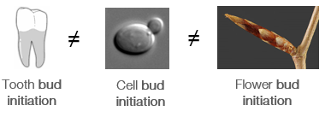
Why using Gene Ontology (GO)?
Natural language is ambiguous
Synonyms (Kreb’s/TCA/citric acid cycle)
Acronyms (T2D for diabetes)
Special characters (COVID19 vs COVID-19)
Typos, error-prone
30% of papers featuring gene names have errors created by spreadsheet autocorrect functions (Nature news)
Computers/machines have no intuitive sense of semantics/context

Slide 3

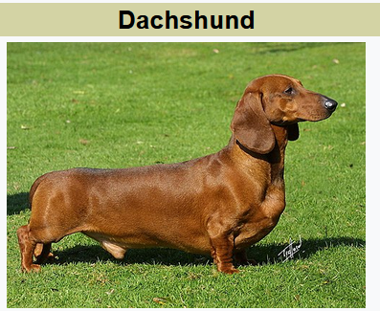
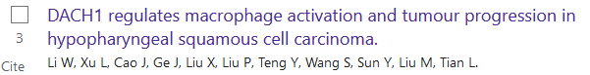
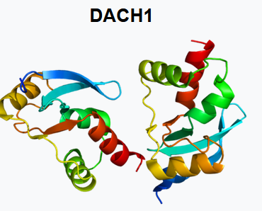

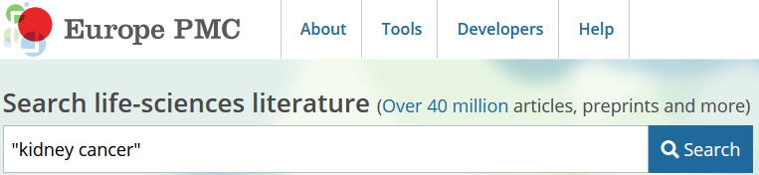
The ambiguity of natural language creates problems when free-text searching
Standardized language prevents ambiguity

Slide 4
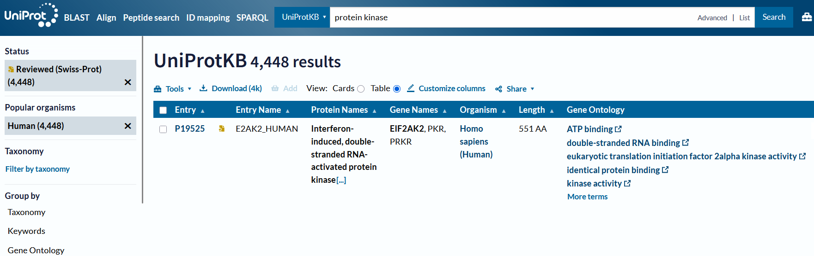
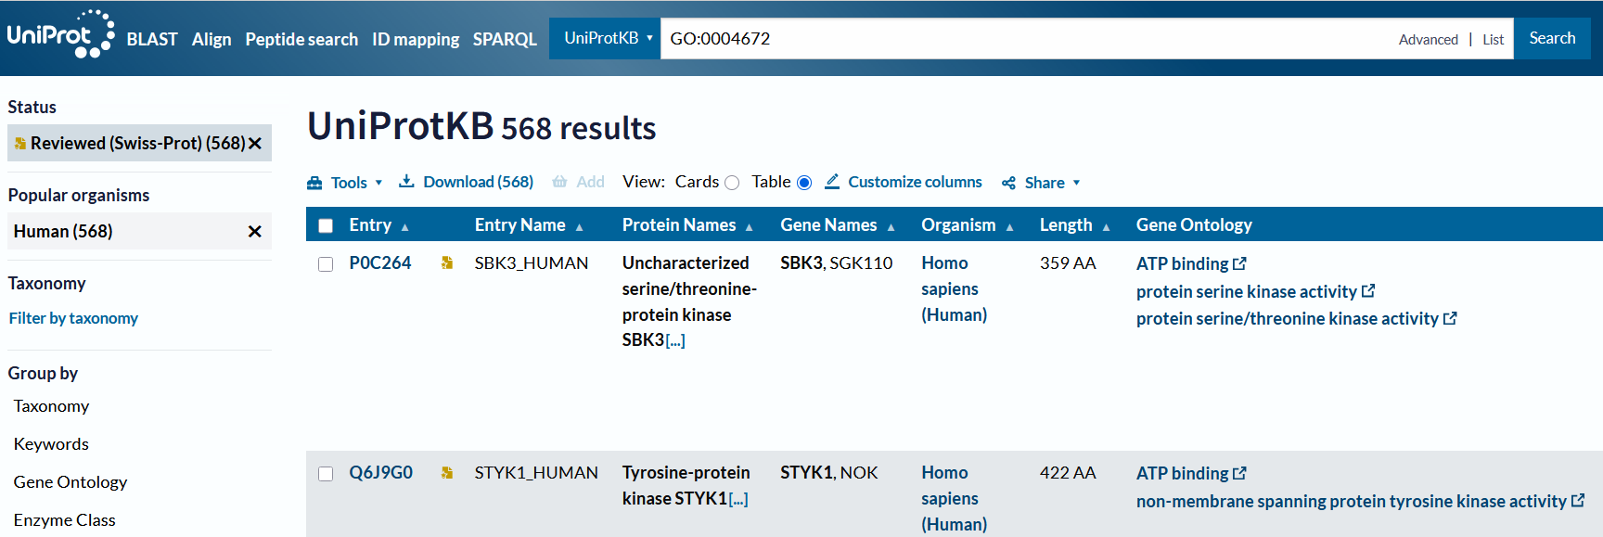
Standardized language enables precise searching
Free text search for “protein kinase” vs GO ontology search for “protein kinase activity” GO:0004672
(human reviewed entries)

Slide 5
Standardized language enables analysis of data
Ontology relationships enable us to not only find data, but also re-organize data in queries
Mitochondrion
Gene 15
Gene 27
Gene 52
Gene 20’000
DNA repair
Gene 1
Gene 3
Gene 10
Gene 100
Protein Kinase
Gene 2
Gene 12
Gene 20
Gene 20,000
Gene 2
Kinase
Cytosol
Signaling
Gene 1
Exonuclease
Nucleus
DNA repair
Gene 20,000
Fumarase
Mitochondrion TCA cycle

Slide 6
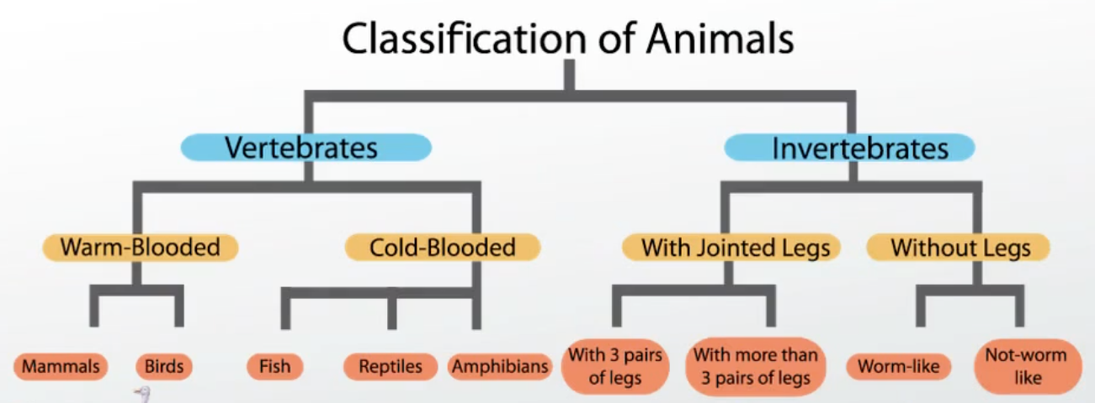
Controlled vocabularies, hierarchies and ontologies
>> Help us build standards for terms used in a particular domain
Controlled vocabularies
Contain fixed terms (/classes/entities) describing concepts within a domain
Definitions help us understand unfamiliar terms, agree on their meaning (avoids ambiguity of natural language)
Allows for indexing and retrieval
“Flat list” / glossary - no relationships connecting terms
Hierarchies
Help categorize concepts
Terms are related via is_a relationship
General (/ancestor/parent) classes may have multiple descendants
A descendant class may only have one ancestor class

Slide 7
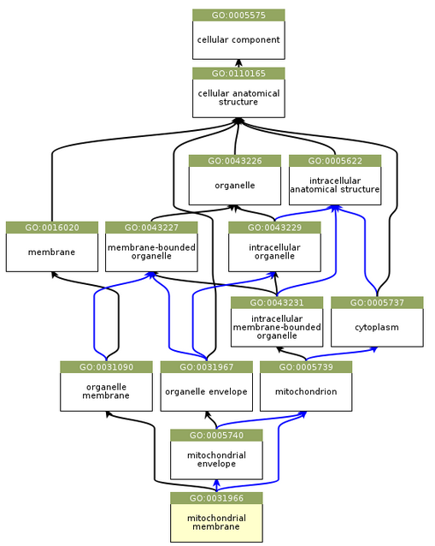
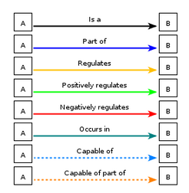
Ontologies use controlled vocabularies to describe concepts in a domain and how they are related in a structured & computable format.
More relationships allowed than in a taxonomy.

Slide 8
The Gene Ontology (GO)
The world’s largest resource on gene functions (http://geneontology.org/)
Built for a specific purpose
Aims to capture biological knowledge and to describe attributes of gene products:
In a species agnostic manner
In language interpretable by humans and machines (ontologies)
Provide a resource for analysis of large-scale datasets
Freely available

Slide 9
Advantages of language organization using GO
Controlled Vocabulary
Hierarchical Structure
Three Ontologies:
Molecular Function
Biological Process
Cellular Component
Directed Acyclic Graph (DAG) (relationships between GO terms)
Species-Agnostic
Annotation and Analysis

Slide 10
What GO is NOT
GO covers ‘normal’ function and processes
NO pathological processes (aging, cancer…)
GO does not try to capture
All experimental conditions
Evolutionary relationships

Slide 11
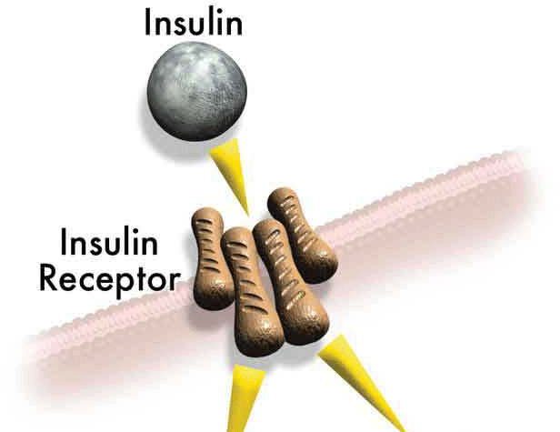
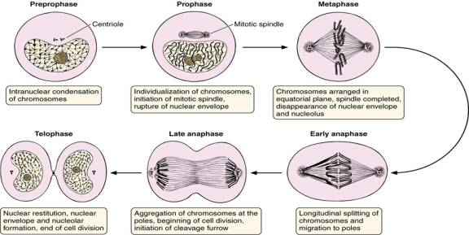
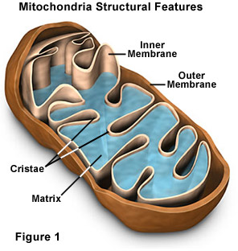
GO provides systematic language to describe gene products (ncRNA and proteins) in three domains
1. Molecular Function
Single step elemental activity or task or job protein kinase activity
insulin binding
2. Biological Process
A commonly recognized series of events - a biological ‘program’
cell division
apoptosis
heart development
3. Cellular Component
Where a gene product is located
mitochondrion
mitochondrial matrix
extracellular region

Slide 12
Terms
Basic unit within an ontology, representing things within a domain
Eg. Endocytosis (GO), hydrogen peroxide (ChEBI), fragile X syndrome (MONDO)
Associated with stable and semantics-free identifiers to promote stability even though ontology representation may change with new scientific knowledge
e.g. GO:0006897, CHEBI:16240 and MONDO:001038)
Terms may be merged
Alternate IDs maintained as secondary identifiers
Terms may be obsoleted
May be no longer needed, considered out of scope, duplicates, etc
Kept for historical records
Obsolete terms may contain metadata pointing to alternative terms

Slide 13
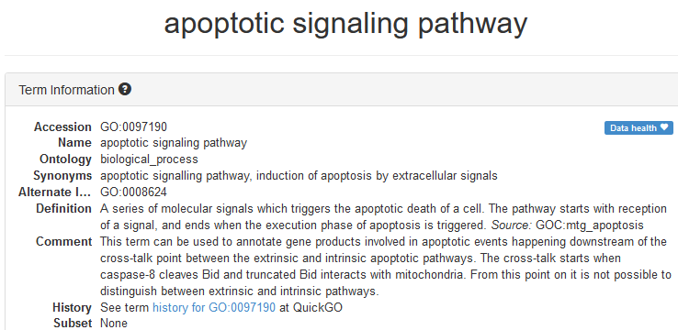
Metadata
Term definition: Both a textual definition (aimed primarily at humans) and logical definition (aimed primarily at machines)
Secondary IDs: (resulting from term merges)
Flags: obsoletion, “do not annotate”
Synonyms: may come in different types, e.g. exact, related, narrow
Cross-references to alternative databases
e.g. GO cross-references EC and Rhea and links to publications supporting the existence of the class
Comments: examples of intended usage

Slide 14
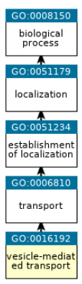
Relationships
GO
general
Terms are arranged in a hierarchy from general to specific
Relations between classes provide structure to the ontology
Broader general/ancestor/parent terms give rise to specific/descendant/child terms
There are no defined “levels” in the ontology, but some terms have a “do not annotate flag” indicating that when annotating, a more specific term should be selected
Relationships enable transitive inheritance of annotations
When annotating to a more specific class, the annotated protein is automatically annotated to all more general classes
A search to a parent term can retrieve all children
specific
Notes:
“do not annotate flag” >> too high level term >> choose a more specific term

Slide 15
Most commonly used relationships
Is_a: is a subtype of
A volvo is_a car
The mitochondrion is an organelle
Part_of:
A wheel is part_of a car
The mitochondrial lumen is part_of the mitochondrion
Regulates:
Positive regulation of transcription by RNA polymerase II positively_regulates transcription by RNA polymerase II
Beware of how the term “regulation” is used by authors – sometimes it’s used when something has an effect on something else, and not ‘intentional’ regulation.
For example, knockout of a gene affects some downstream pathway vs. a protein inhibitor binding a target directly to inhibit a pathway
Notes:
the term “regulation” should only be used for direct regulation, not indirect effects of knockouts/knockdown..

Slide 16
Making GO annotations
GO consists of two parts: the ontology and the annotations
An annotation is an association of a gene product with an ontology term
An assertion that the gene product performs an activity/localizes to a space, participates in a process…
Annotations can be created manually or automatically
“Electronic” (automatic) annotations are not manually reviewed (but the pipeline is), typically based on homology or other sequence information such as domains
E.g. any protein with a kinase domain are annotated to “kinase activity”
Annotations manually created by curators may be derived from the literature (experimental or author statements), sequence (e.g. homology), or by curatorial judgement (e.g. a paper demonstrates a protein is a transcription factor, a curator might then infer that the protein localizes to the nucleus)

Slide 17
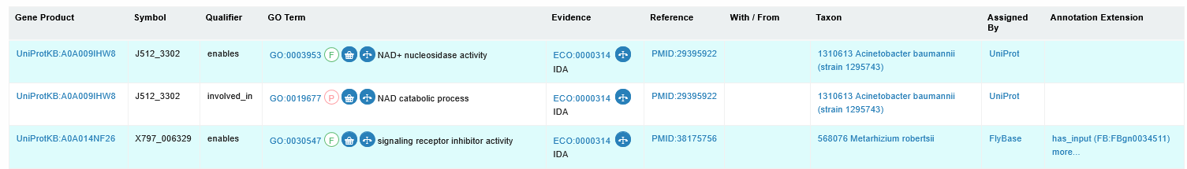
Parts to a GO annotation
Requirements:
Protein ID (UniProt ID)
GO term (GO ID and/or GO value)
Evidence
Reference (PMID)
Additional information/context (“annotation extension”)

Slide 18
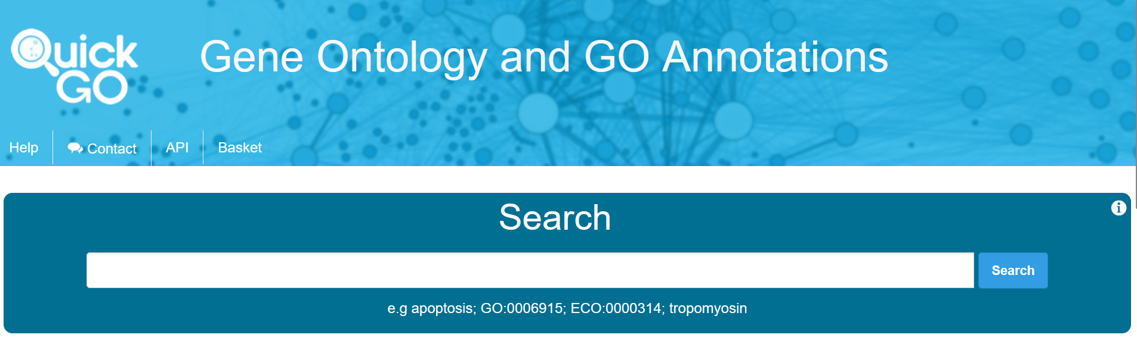
Finding and selecting terms in QuickGO
Ontology browsers (e.g. QuickGO, AmiGO) enable term browsing
Look at existing annotations, including orthologs or related genes – what have other curators annotated to
https://www.ebi.ac.uk/QuickGO/

Slide 19
Finding and selecting terms in the ontology
In P2GO, the term search field doesn’t show ancestor terms or child terms, only exact matches to text
Sometimes it is easier to ‘drill down’ the ontology, than to directly search for an exact term (start at a higher level term, for example a slim term or a general process such as “DNA repair”, and view children)
Ontology browsers (e.g. QuickGO, AmiGO) enable term browsing
Look at existing annotations, including orthologs or related genes – what have other curators annotated to?
Good opportunity to review existing annotations and change anything that is incorrect!

Slide 20
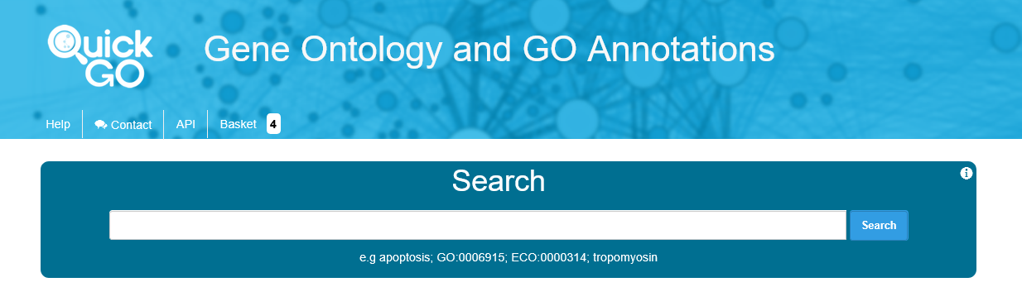
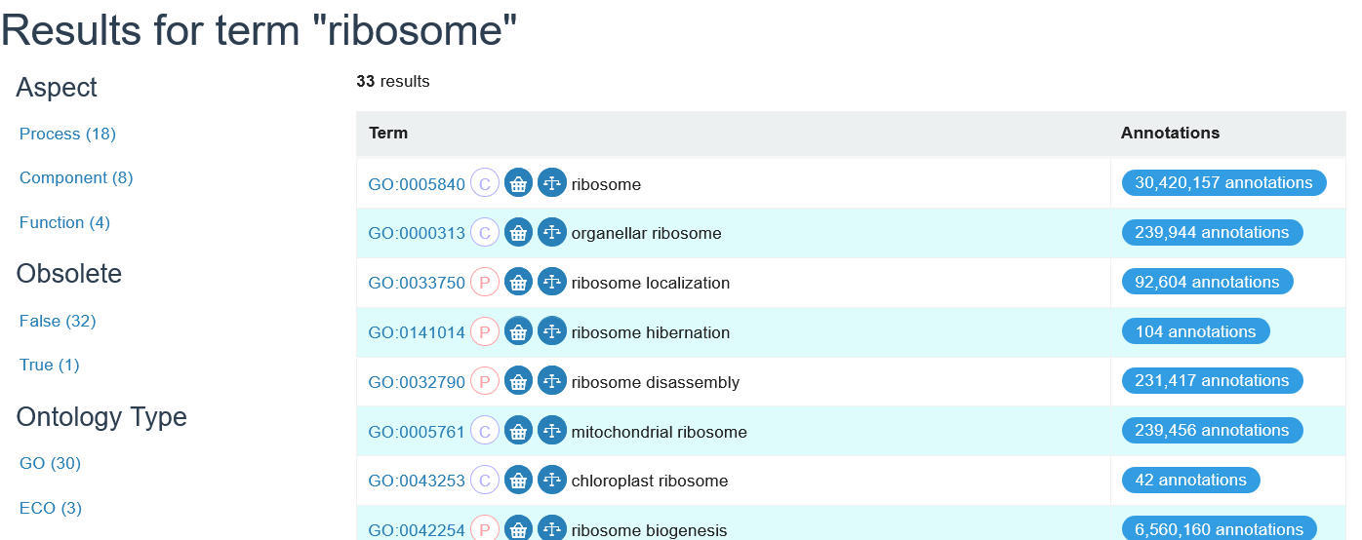
https://www.ebi.ac.uk/QuickGO/
Search for a term; either select a term from the drop down or click enter and filter on process, component function

Slide 21
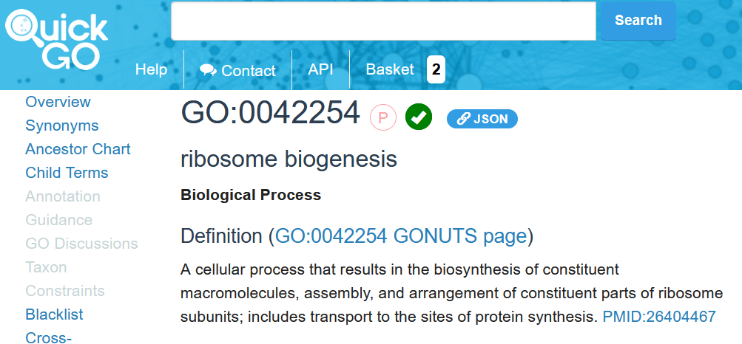
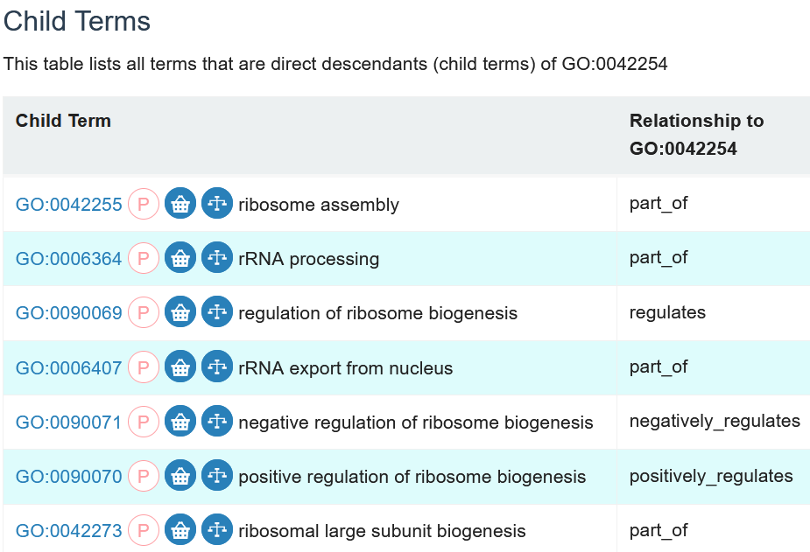
Term page
On term pages, you can view definition, taxon constraints, cross references etc.
You can navigate to more specific terms (child terms) or view less specific terms & relationships in the ontology using the ancestor chart

Slide 22
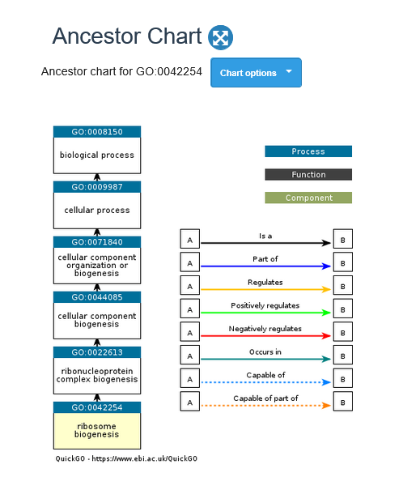

Slide 23
The relationships between multiple terms can be explored in ancestor trees
Rrna processing
Ribosome biogenesis
Maturation of SSU-RNA
Ribosomal large export from the nucleus
How are these terms related?
Useful tool for deciding between terms

Slide 24


Comparing parentage of ontology terms using the quickgo “ancestor chart”
Go to QuickGO https://www.ebi.ac.uk/QuickGO/
Put the terms in the “shopping basket”
Click on the “basket” in the top menu and then the symbol to view their shared ancestry

Slide 25
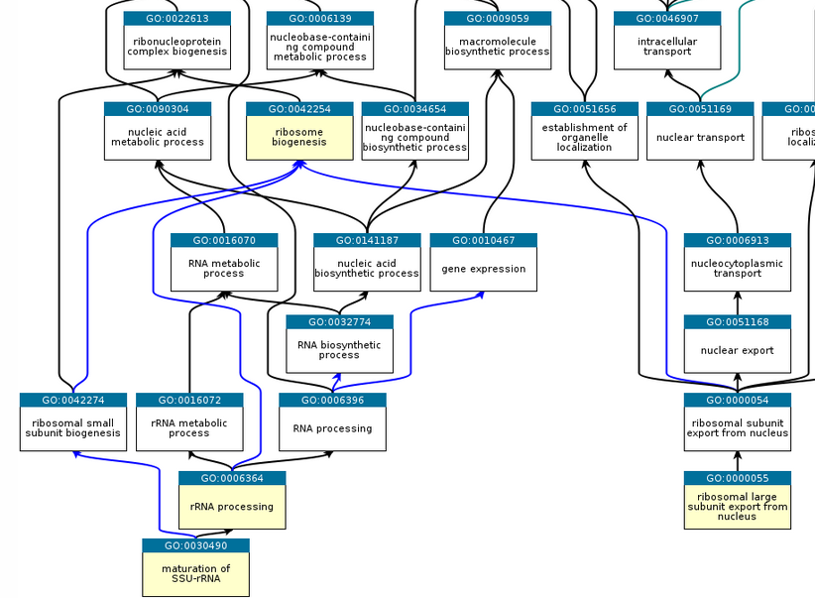
Ribosome biogenesis is a common parent to the other 3 terms

Slide 26
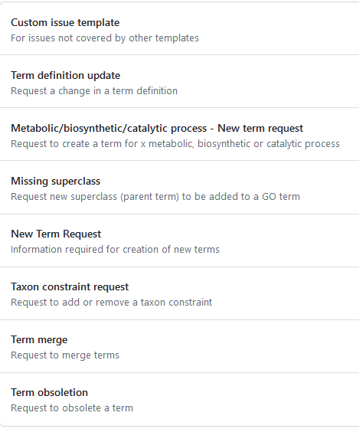

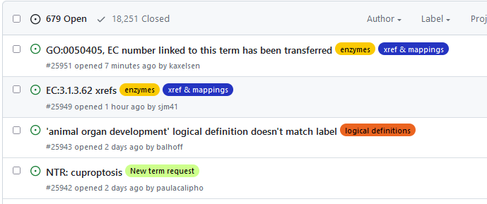
Requesting new terms, ontology editing etc
If a term doesn’t exist, a relationship looks wrong etc
GO github tracker
https://github.com/geneontology/go-ontology/issues

Slide 27
Evidence codes
Indication of the evidence underlying the annotation
Electronic vs. experimental
Mutagenesis versus direct assays
Orthology, author statement, inferred by curator….

Slide 28
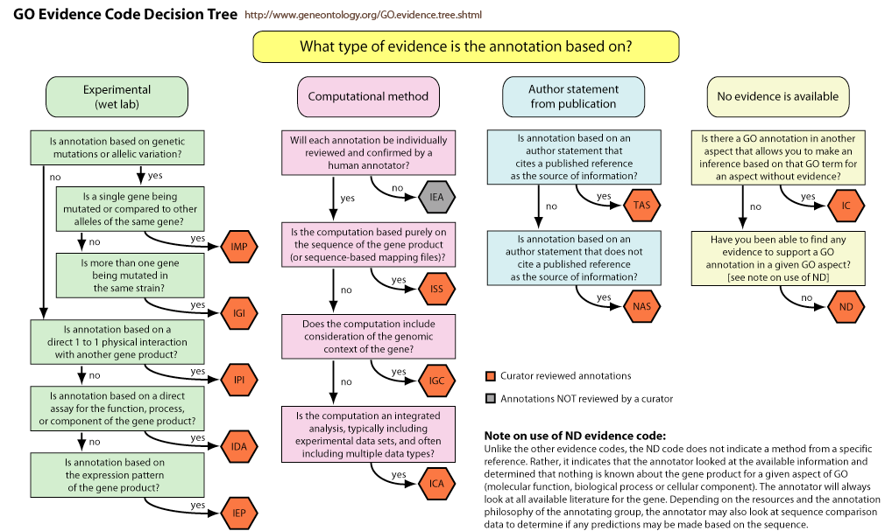
Evidence code decision tree
Notes:
Suptypes of experimental (EXP) evidence codes:
IMP: Inferred from Mutant Phenotype (IMP)
IGI: Inferred from Genetic Interaction (IGI)
IPI: Inferred from Physical Interaction (IPI)
IDA: Inferred from Direct Assay (IDA)
IEP: Inferred from Expression Pattern (IEP)
The computational analysis evidence codes are:
ISS: Inferred from Sequence or structural Similarity (ISS)
IGC: Inferred from genomics Context (IGC)
ICA:
Author statement evidence codes
Traceable Author Statement (TAS)
Non-traceable Author Statement (NAS)
Curator statement evidence codes Inferred by Curator (IC)
No biological Data available (ND)
Inferred from Electronic Annotation (IEA)

Slide 29
With/from column
Used with the IPI and IGI evidence codes (inferred from physical/genetic interaction)
IPI must be used with the “protein binding” GO term – when a gene product and another protein bind each other directly.
The interactor is specified in the with/from column

Slide 30
Annotation extensions
Add additional detail to GO annotations
E.g. The protein substrate of a kinase, “happens during” a cell cycle phase or other process, specify cell type etc
Provide curated, directional links between gene products
supports network construction

Slide 31
Gene product to GO term relations (gp2term)
Relations from the Relations Ontology (RO) are used to explicitly link gene products to GO terms.
Relations between a gene product and a Molecular Function (MF):
enables links a gene product to an MF it executes (default in P2GO)
contributes to links a gene product to an MF executed by a complex, in which the MF cannot be ascribed to an individual subunit of that complex. Only annotate subunits required for the MF to the term with ‘contributes to’.
Relations between a gene product and a Biological Process (BP):
involved in links a gene product and a BP in which the gene product’s MF plays an integral role.
Relations between a gene product and a Cellular Component (CC):
is active in links a gene product to the cellular location in which it enables its MF
located in links a gene product and the CC, specifically a cellular anatomical anatomy or virion component, in which a gene product has been detected (default in P2GO)
part of links a gene product and a protein-containing complex (default in P2GO for complex terms)
For the full list of permitted gp2term relations, see the GO wiki

Slide 32
NOT annotations
The NOT statement indicates that the gene product does NOT enable a Molecular Function, is not part of a Biological Process or is not located in or active in a specific Cellular Component
Use only when something was expected but shown not to be true (for example, the protein was expected to have a catalytic activity based on the domains present, but then this was shown not to be true)
Take care - don’t use for negative or inconclusive results
Unlike “positive” annotations that propagate up the ontology tree, NOT annotations propagate down the ontology
E.g. if a protein is NOT a protein kinase, then it could still be a kinase (more general term) but it cannot be a serine/threonine protein kinase (more specific term)

Slide 33
Direct vs indirect / downstream effects
Beware of how the term “regulation” is used by authors – sometimes it’s used when a mutation has an effect on something else, and not ‘biologically intentional’ regulation.
For example, knockout of a gene disrupts some downstream pathway vs. a protein inhibitor binding a target directly to inhibit a pathway
Only annotate a gene to processes that it is directly involved in (to the best of knowledge). Do not annotate downstream/indirect effects
Mutant mice have defects in heart development, leading to defects in heart contraction - do not annotate to heart contraction, annotate to heart development (contraction problem happens because the heart didn’t develop properly)
A yeast cell with a mutation meaning that can’t form its cell wall properly may have mating defects (it can’t fuse with other yeasts). The gene should be annotated to cell wall formation, not sexual reproduction.
Mutations in a gene involved in silencing by RNAi may have increased expression of some transcripts. The gene is involved in silencing by RNAi, not transcription.
Mutation in a genes involved in heterochromatin formation may lead to transcription of parts of the genome that are normally silenced. The gene should be annotated to heterochromatin formation, not gene silencing.

Slide 34
Annotate to biologically meaningful terms
Some terms only exist to organize the ontology – they are ‘too high level’ to provide any useful information about protein function, or it should always be possible to be more specific
“Metabolic process”: over half of an organism’s genes may be involved in metabolism, but they participate in completely different pathways e.g. DNA metabolism, amino acid metabolism, carbohydrate metabolism, lipid metabolism. Therefore, annotating to the more generic ‘metabolism’ does not really say anything about the function of the protein.
Translation and cell cycle – it should always be possible to specify cytoplasmic vs mitochondrial translation and mitotic vs meiotic cell cycle
The generic GO slim (also called subset) provides an overview of high level terms that are useful descriptors of biology
The “generic GO slim” is what is displayed in the ribbon on Uniprot protein pages (configurable for different organisms)
it can be downloaded in flatfile format here: https://geneontology.org/docs/download-ontology/
Always annotate as specifically as possible (less specific terms are automatically annotated to)

Slide 35
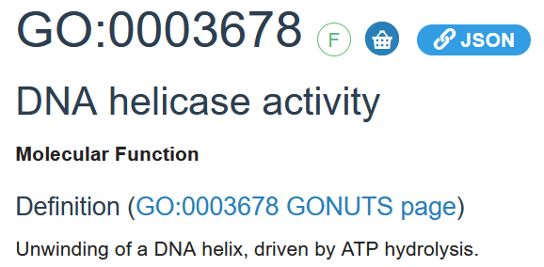
RecQ4
Helicase assays were carried out in the presence of ATP, or the non-hydrolysable ATP analogue AMP-PNP, leading us to observe a significantly higher level of dissociation in the presence of ATP compared with the reactions containing AMP-PNP (Figure 2C). This observation shows that the majority of the dissociated ssDNA products result from ATP-dependent DNA unwinding driven by the RECQ4 helicase

Slide 36
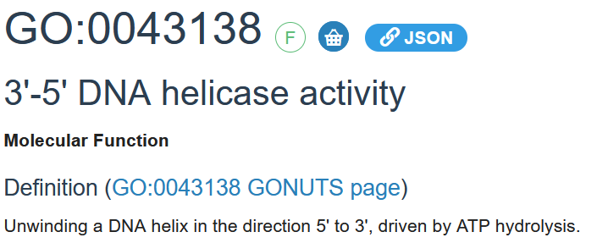

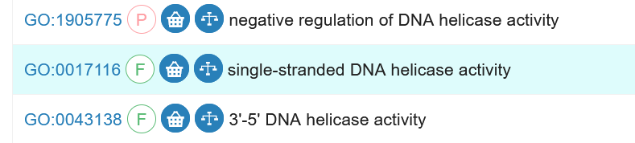
As expected, although DNA unwinding was observed with both substrates, RECQ4 showed a preference towards the 3'-overhang structure (Figure 2F, lower panel) compared with the 5'-overhang substrate (Figure 2F, upper panel). These results show that RECQ4 exhibits a 3' 5' polarity.
Notes:
Further experiments supported a more specific GO term

Slide 37
prp4
We provide evidence that Prp4p kinase activity is required for pre-mRNA splicing in vivo and show that loss of activity impairs G1-S and G2-M progression in the cell cycle. Prp4p interacts genetically with the non-SR (serine/arginine) splicing factors Prp1p and Prp5p. Bacterially produced Prp1p is phosphorylated by Prp4p in vitro. Prp4p and Prp1p also interact in the yeast two-hybrid system. In vivo labelling studies using a strain with a mutant allele of the prp4 gene in the genetic background indicate a change in phosphorylation of the Prp1p protein. These results are consistent with the notion that Prp4p kinase is involved in the control of the formation of active spliceosomes, targeting non-SR splicing factors.
+ interpro IPR008271Ser/Thr_kinase_AS
BP: mRNA cis splicing, via spliceosome
IMP evidence
Do not annotate to regulation of the G1/S or G2/M transition of the cell cycle – these are phenotypes that result from the splicing defect.
MF: protein serine threonine kinase activity
Annotation extension: has_input:prp1
IDA evidence
Notes:
Annotate to the process the protein is directly involved in

Slide 38
Cys1a and cys1b
Cysteine synthase catalyzes the formation of cysteine from O-acetylserine, and is the key enzyme for de novo cysteine biosynthesis in Schizosaccharomyces pombe. An examination of the S. pombe database revealed that two gene products are predicted to encode proteins homologous to eukaryotic cysteine synthases. Disruption of one of these candidates, cys1a+ (SPBC36.04), caused an obvious cysteine auxotrophy, while disruption of cys1b+ (SPAC3A12.17c) had no effect on the growth phenotype. Furthermore, overexpression of cys1b+ did not complement the cysteine auxotrophic phenotype of cys1a mutant cells. These results indicated that cys1a+, not cys1b+, primarily functions in the biosynthesis of cysteine in S. pombe cells. We constructed a bacterial-S. pombe shuttle vector containing cys1a+ as a selective marker gene. The combination of the cysteine auxotroph and new vector could be useful for the expression of a heterologous protein.
Cys1a
MF: Cysteine synthase activity
IMP evidence
BP: Cysteine biosynthetic process from serine
IMP evidence
Cys1b
MF: NOT Cysteine synthase activity
IMP evidence
BP: NOT Cysteine biosynthetic process from serine
IMP evidence

Slide 39
Extract experimental data form community submissions
Info here: ISMB CollaborationFest 2025 - Open Bioinformatics Foundation
Github repository for Gene Ontology Annotations exercise:
https://github.com/anphan0828/ISMB_CollaborationFest_EBI
Objective: Extract experimental evidence from scientific literature for proteins:
GO annotation manually or with LLMs
UniProt line-type style annotation extraction from literature
Text-style summaries of literature
The dataset can be found here
Results: Spreadsheet or word file here: Results_CollaborationFest_GOA

Slide 40
Resources
GO website documentation
https://geneontology.org/search.html
Introduction to GO annotations https://geneontology.org/docs/go-annotations/
Annotation guidelines (primarily aimed at curators)
https://wiki.geneontology.org/Annotation_guidelines
Specific curation guides E.g.
Transcription factors https://docs.google.com/document/d/1bqCxx7QUblrc9q4PIynbJzoCXv248UWBxJa7fguJyXs/edit#heading=h.pwxacfdlynjn
Chromatin remodeling https://docs.google.com/presentation/d/15fDBhmO54zSJms25aV5nX3kgSwsHMnWgdSuPdo-ukyw/edit#slide=id.gf4888089cb_0_59
Signaling https://docs.google.com/document/d/1ukxL3vKfLbV4NAiGSeGg3EbpLKijfXXOr0npHeUYLI4/edit#heading=h.9ixhtvdrf3ju
Evidence codes: https://geneontology.org/docs/guide-go-evidence-codes/
Github:
Onboarding: https://wiki.geneontology.org/New_member_onboarding#Checklist_for_all_Gene_Ontology_Consortium_Members_and_Contributors
Ontology: https://github.com/geneontology/go-ontology/issues
Annotation: https://github.com/geneontology/go-annotation/issues

